Slide 1
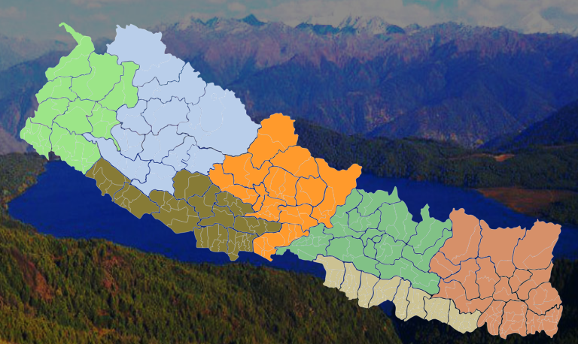


NEPAL

Slide 2
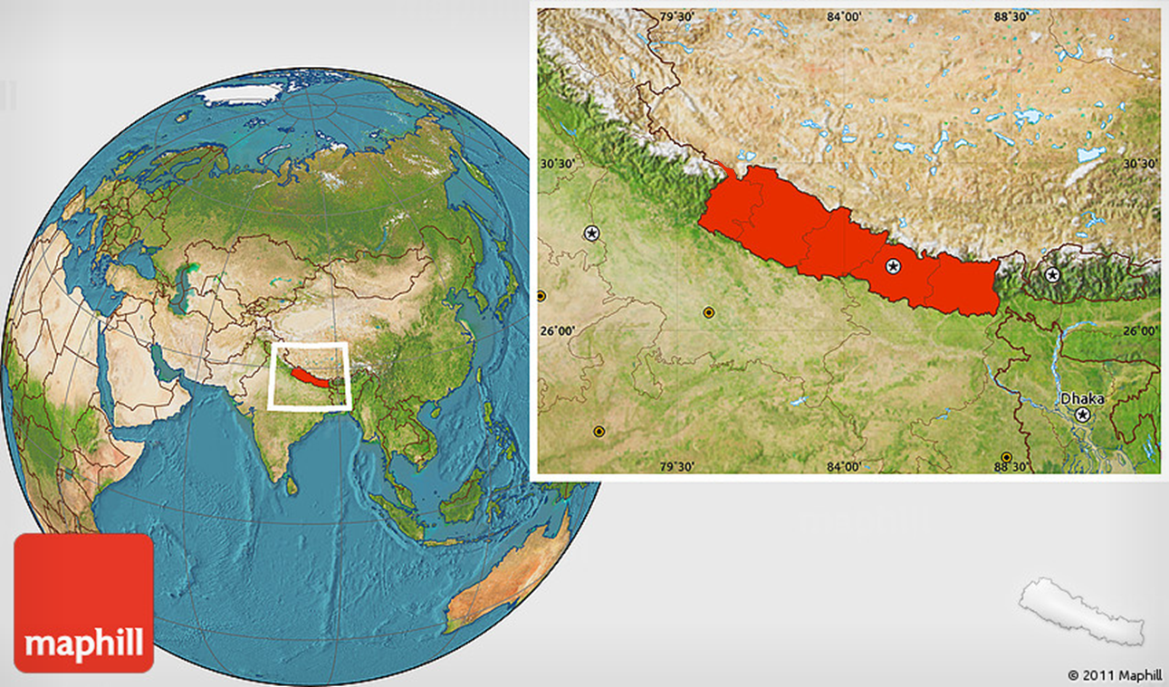
Nepal on the Globe

Slide 3
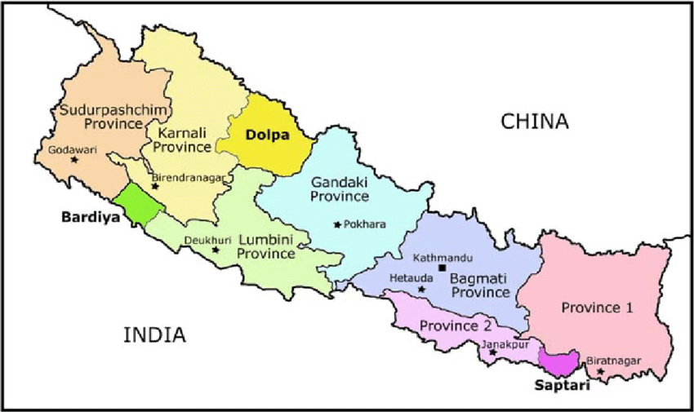
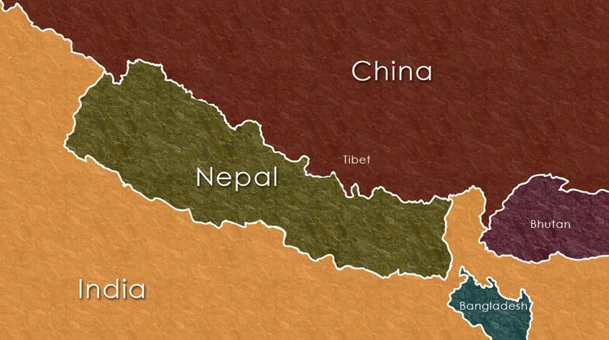
Geography
Land locked country between China and India.
885 kilometres (550 mi) long and 193 m (120 mi) wide
Area 147,181 km² (56,827 sq mi)
lies at latitudes 26° 22’ - 30° 27’,
and longitudes 80° 04’ - 88° 12’ E
Nepal is :
0.03% of world
0.03% of Asia
2.82 % of South Asia

Slide 4
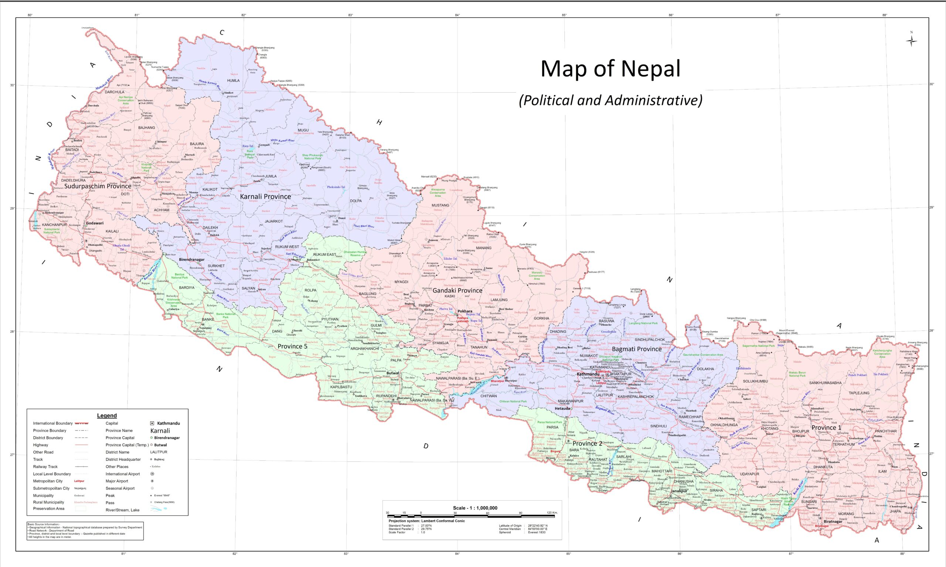
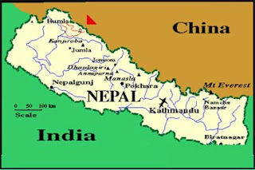
Geography (cont..)
1127 km from Bay of Bengal (nearest sea contact)
Surrounded by :
South (India)
Bihar
Uttar Pradesh (U.P.)
West (India)
Uttrakhand
East (India)
West Bengal
Sikkin
North (China)
Tibbet

Slide 5
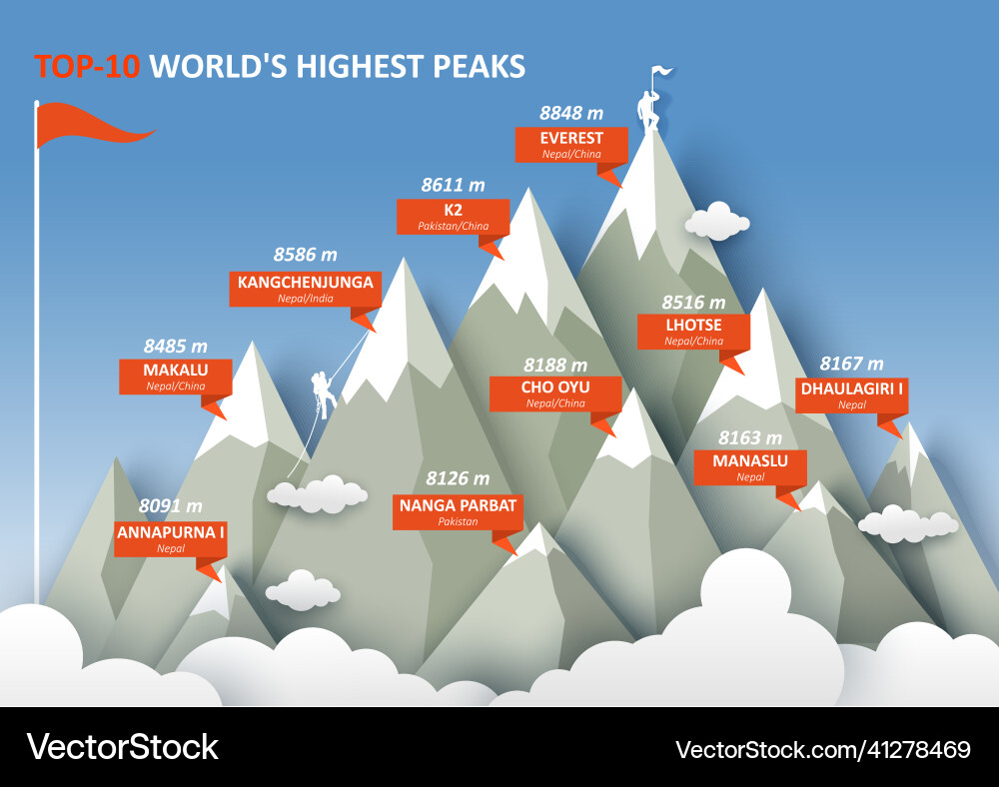
8 in NEPAL

Slide 6
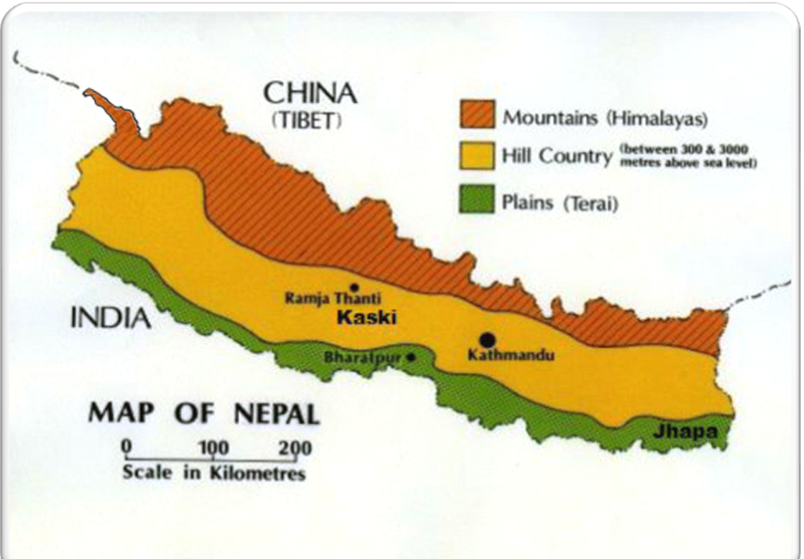
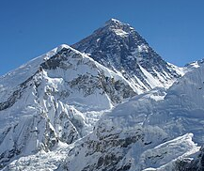

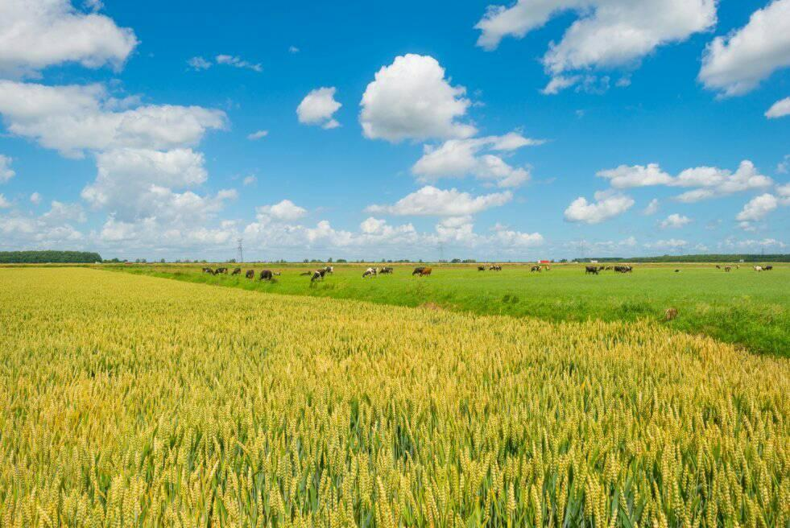
Physiographic Division
Mountainous Region 35%
Hilly Region
42%
Terai Region
23%
Mountainous Region
18%
Hilly Region
65%
Terai Region 17%

Slide 7


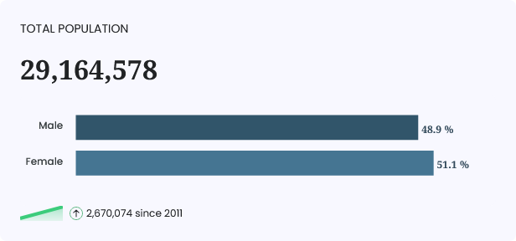



Population

Slide 8

NATURAL
RESOURCES
OF
NEPAL

Slide 9
Nepal's land divided in 11 categories
Forested land,
Agricultural land,
grassland,
bush,
marshland,
snow land,
glacier,
rock,
flood land,
shelter land
and vegetation-less land.

Slide 10



Types of Forest
S.N. | Types of Forest | Altitude
1. | Sub Tropical Evergreen Forest | Upto 1200m
2. | Temperarate Deciduous Forest | 1200m to 2100m
3. | Conferous Forest | 2101m to 3350m
4. | Alpine Forest | 3351m to 5000m
5. | Tundra Vegetation | 5001m and above

Slide 11
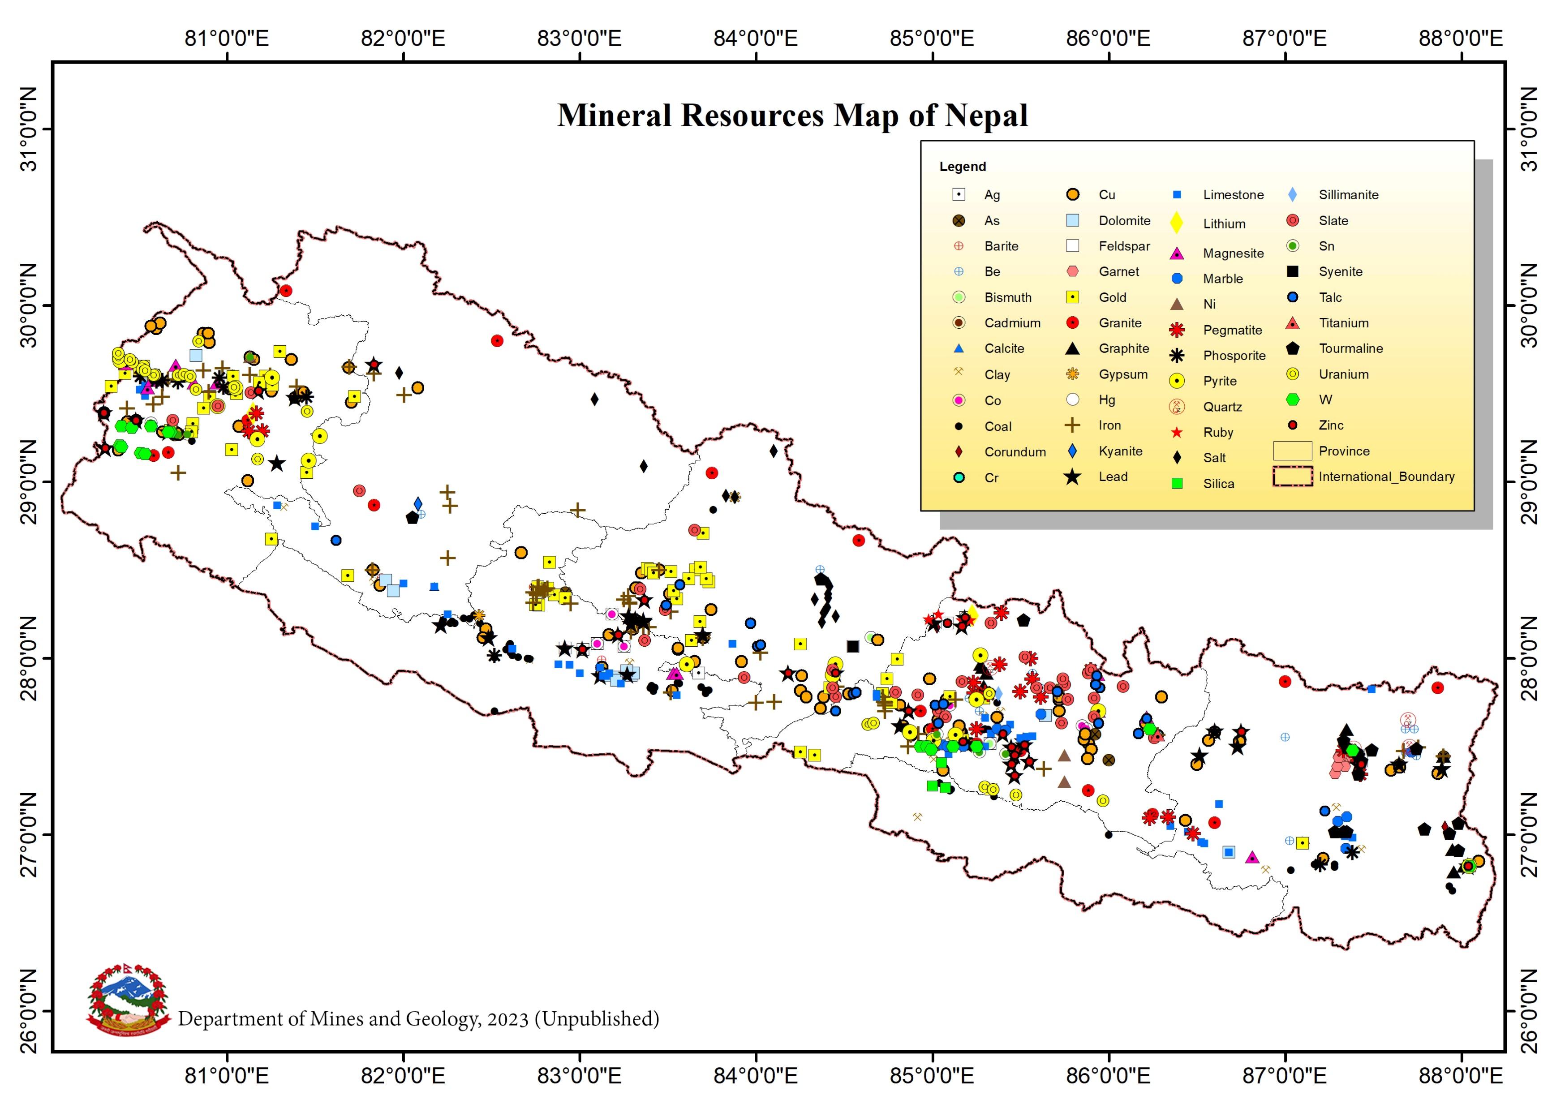

Slide 12
Minerals …
Mineral Types | Mineral Names
Metallic minerals | Antimony, Arsenic, Bismuth, Cadmium, Chromium, Cobalt, Copper, Gold, Iron, Lead, Zinc, Lithium, Mercury, Molybdenum, Nickel, Silver, Tantalum/Niobium, Tin, Titanium, Tungsten and Uranium.
Non metallic industrial minerals | Barite, Calcite, Clay, Common Salt, Corundum, Dolomite, Feldspar, Garnet, Graphite, Magnesite, Mica, Ocher, Pegmatite, Phosphorite, Pyrite, Silica Sand, and Sillimanite that are used to make chemicals, fertilizers, insulators, ceramics, refractories and abrasives.
Non-metallic Gem minerals | Beryl and Aquamarine, Kyanite, Quartz, Ruby, Sapphire and Tourmaline.
Non-Metallic construction materials | Basic Rocks, Boulder, Gravel and Sand, Granite, Gypsum, Limestone, Marble, Quartzite, Slate, Syenite.
Fuel Minerals and Thermal Springs | Coal, Geothermal Hot Spring, Natural Methane Gas, Petroleum and Natural Gas.

Slide 13


Slide 14
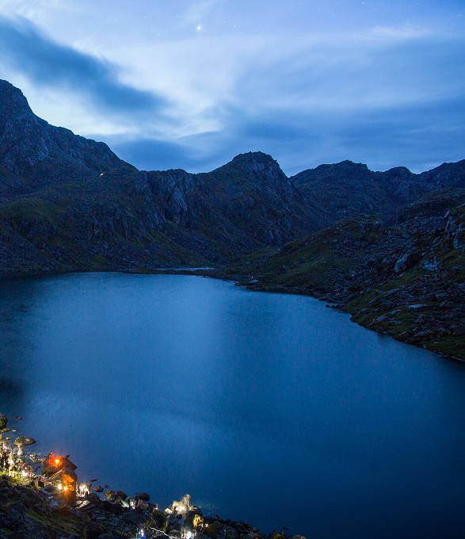
Water Resources
43rd rank in world
Rivers: 45,000 km
length,
Area over 200 BCM
of annual surface runoff

Slide 15
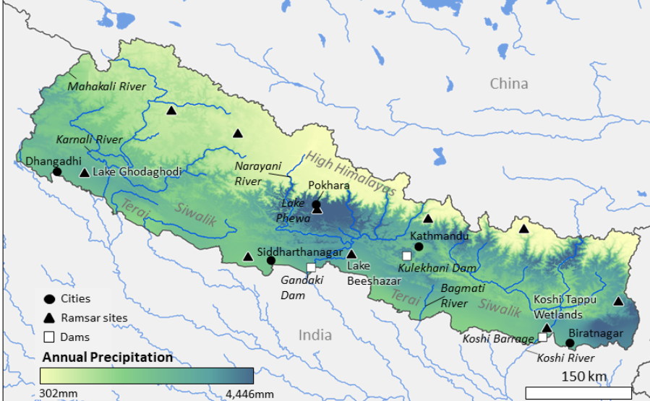

Slide 16
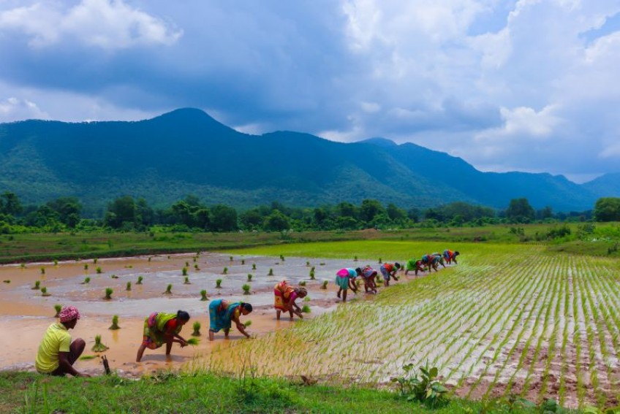
Agriculture
in Nepal

Slide 17
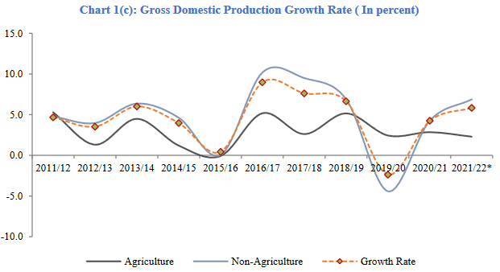
Agriculture Contribution in GDP

Slide 18
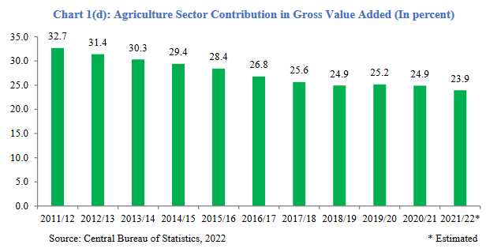
Agriculture Contribution in GDP

Slide 19
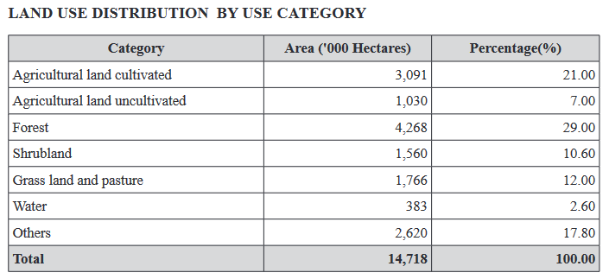
Agriculture by Land Use

Slide 20
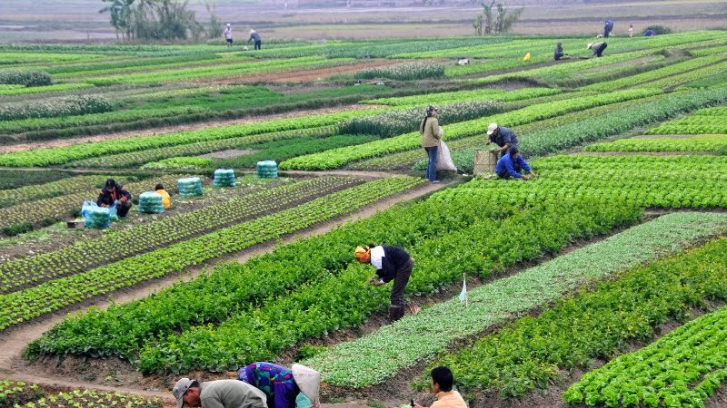
Nepal's Status, Development, and Challenges in Storage, Preservation, and Commercial Distribution of Fruits and Vegetables

Slide 21
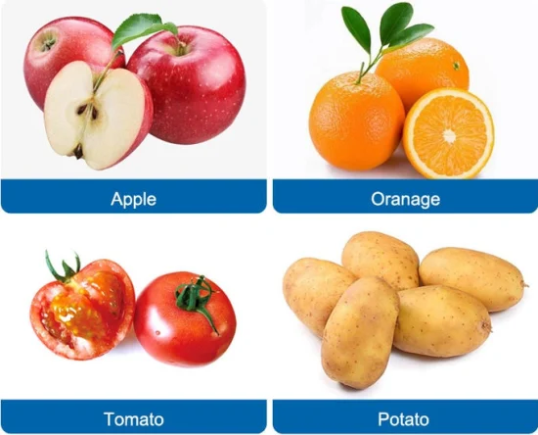
Current Status
Agricultural Sector Contribution: 27% of GDP (2023)
Employment: 65% (agriculture)
Major Fruits and Vegetables Production:
Mango : 498,859 metric tons (2021-2022)
Oranges: 125,000 metric tons annually
Apples: 60,000 metric tons annually
Tomatoes: 150,000 metric tons annually
Potatoes: 2.5 million metric tons annually

Slide 22
Production of Mango
Mango production has been increasing in the country over the past few years.
According to the Department of Agriculture, in the fiscal year, 2020/21, a total of 466,267 metric tonnes of mango was produced from 43,689 hectares of land. In the FY 2021/22,
The production has increased to 498,859 metric tonnes from 39,579 hectares of land.
In the current FY, 2022/23, the production has increased from 10.67 to 12.61 metric tonnes each hectare.

Slide 23
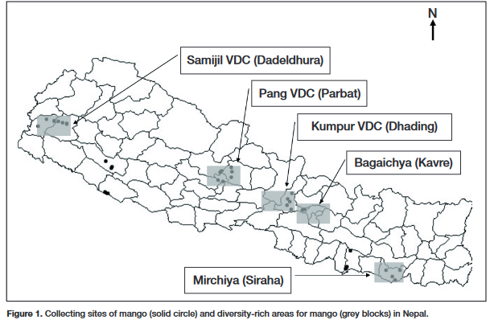
Mango Collection sites

Slide 24
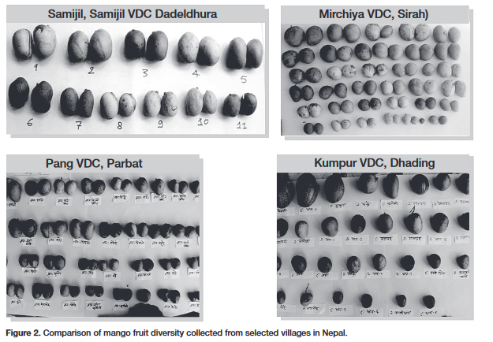
Mango comparison:

Slide 25
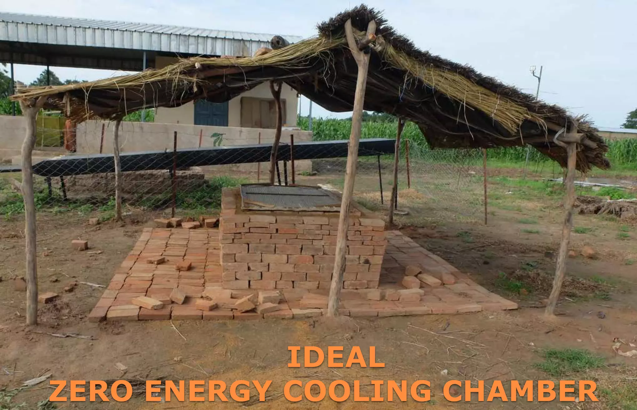
Mango storage…
Traditional method:
Zero Energy Cool Chamber (ZECC):Description: ZECC is a low-cost, eco-friendly storage method that does not require electricity. It uses evaporative cooling to maintain a lower temperature inside the chamber.

Slide 26
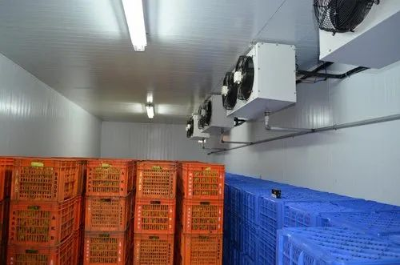
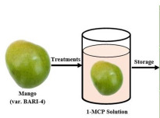
Mango storage…
Modern Method
cold storage :
Temperature Control: Cold storage units maintain temperatures between 12°C and 15°C with high humidity to slow down the ripening process and reduce spoilage.
Post Harvest Treatment:
Chemical Treatments: Use of substances like 1-Methyl Cyclo Propane (1-MCP) to control ethylene production and reduce spoilage.

Slide 27
Production of Apple
FY 2020/21:
Area Harvested: Approximately 5,000 hectares.
Production Quantity: Around 50,000 metric tons.
Yield: About 10 metric tons per hectare1.
FY 2021/22:
Area Harvested: Approximately 5,200 hectares.
Production Quantity: Around 52,000 metric tons.
Yield: About 10 metric tons per hectare1.

Slide 28
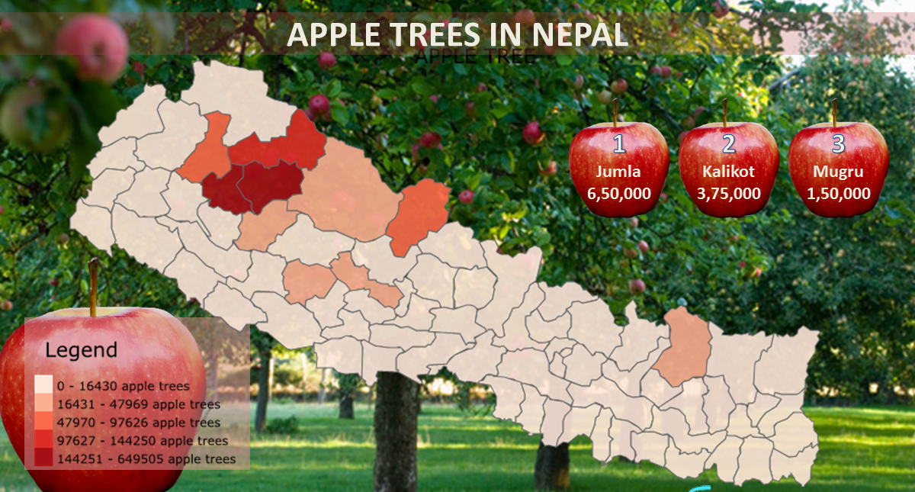
Apple harvesting sites in Nepal

Slide 29
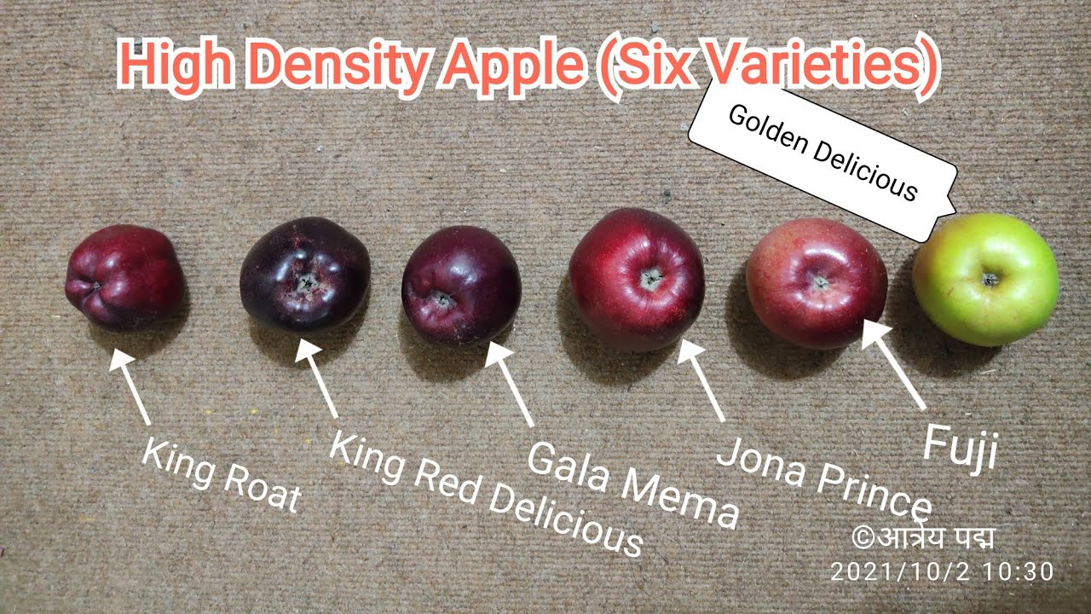
Apple types:

Slide 30
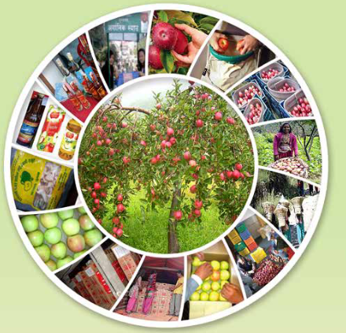
Apple storage in Nepal

Slide 31
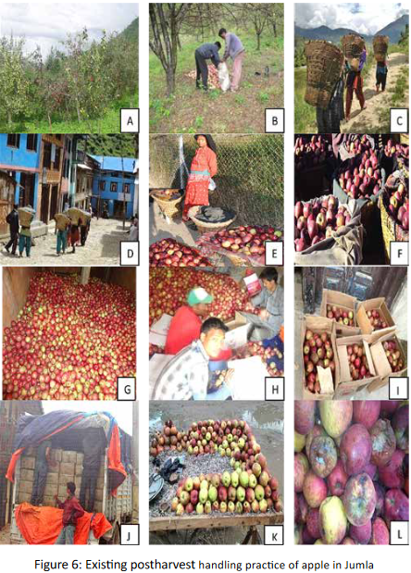
Ordinary
Storage
System

Slide 32
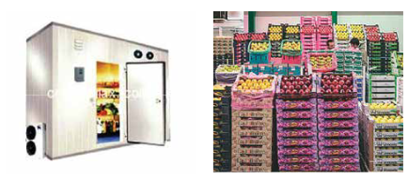
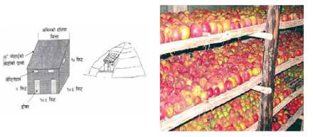
Apple Storage….
Cold Storage
Traditional Cellar Storage

Slide 33
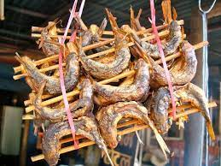
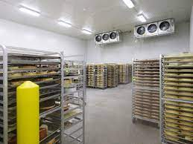
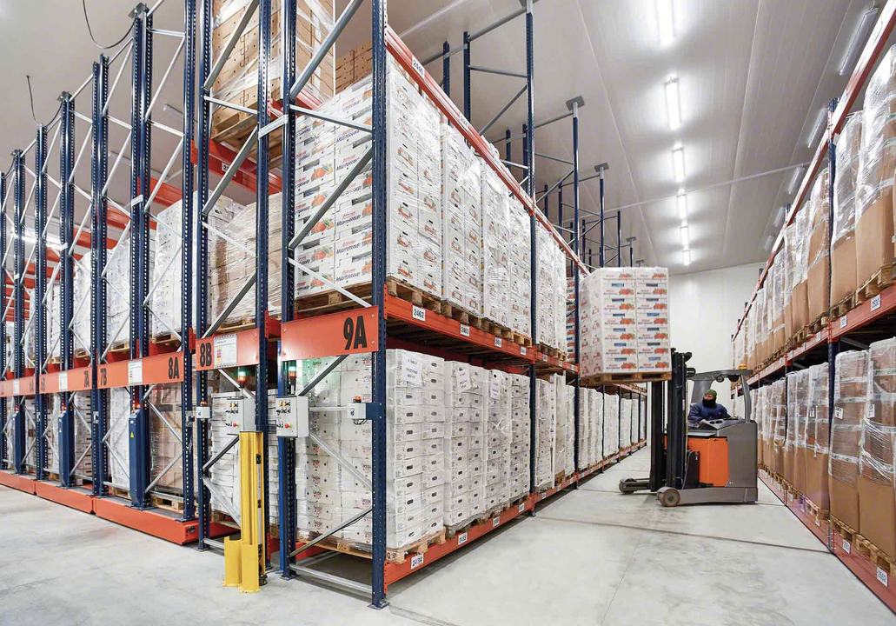
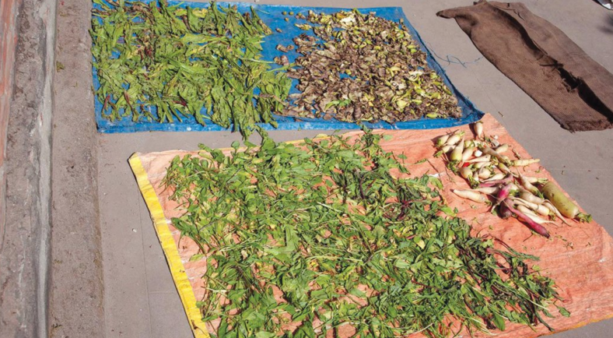
Production Areas:
Terai region: 55%
Mid-hills: 30%
High mountains: 15%

Slide 34


Government Initiatives:
Subsidies:
$5 million allocated for cold storage construction (2022)
Training programs:
10,000 farmers trained in post-harvest management

Slide 35
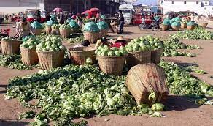
Challenges in Storage
Infrastructure:
Cold storage deficit:
40,000 metric tons
Post-harvest losses:
25% of total
production

Slide 36
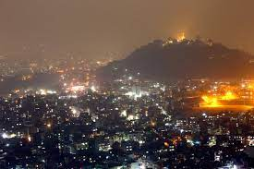
Energy Supply:
30% of cold storage facilities face frequent power outages
Technology Adoption:
Modern storage technology adoption rate: 20%

Slide 37
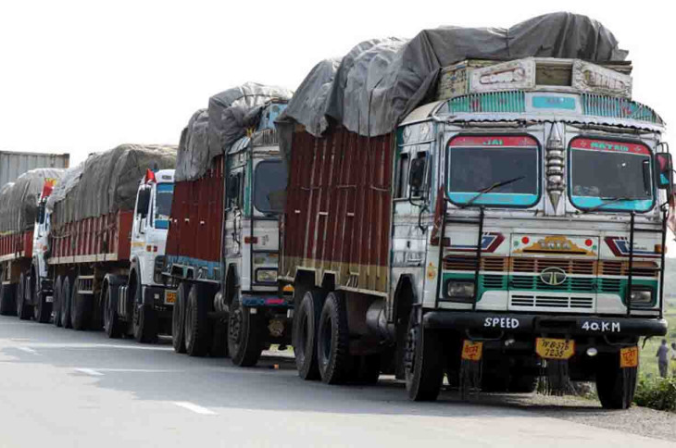
Challenges in Storage (conti…)
Logistics:
40% of rural road connectivity
Supply Chains:
25% increase in private sector investments in agribusinesses

Slide 38
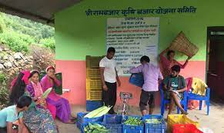
Development in Commercial Distribution Market Linkages:
150 collection centers established
200 cooperatives involved in distribution

Slide 39

Challenges in Storage (conti…)
Export Potential:
Export value: $50 million for high-value crops (2023)
Major export markets: India, China, and the Middle East
Export barriers: 20% of potential exports blocked due to regulatory issues .Being land locked Country also plays a vital role as Challenge in Export and Storage

Slide 40

Challenges in Storage (conti…)
Commercial Distribution Market Access:
Only 30% of farmers have access to national markets
Price Fluctuations:
Price volatility:
30% seasonal price variation

Slide 41

Quality Control:
40% of produce fails to meet quality standards for exportValue
Chain Integration:
Fragmented supply chain:
50% of stakeholders lack coordination

Slide 42
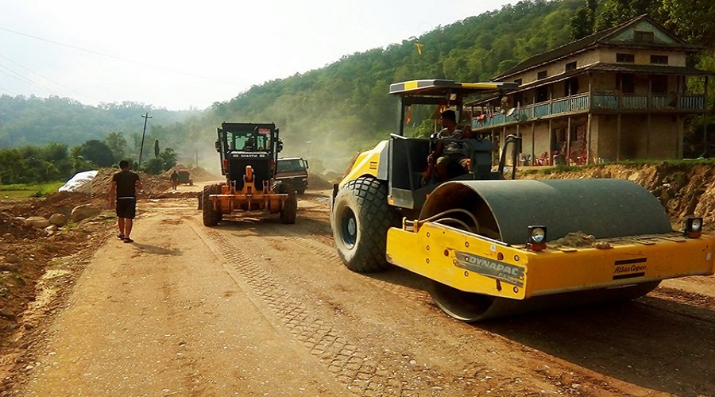
Recommendations
Infrastructure Development:
Increase cold storage capacity by 20,000 metric tons
Improve road connectivity to cover 80% of rural areas
Capacity Building:
Train an additional 20,000 farmers in modern preservation techniques

Slide 43

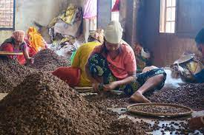
Policy Support:
Increase subsidies to $10 million for storage facilities
Simplify export regulations to reduce barriers by 50%
Market Expansion:
Establish 50 new collection centers
Integrate value chains with digital platforms for better coordination

Slide 44
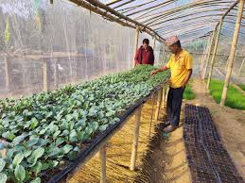
Research and Development:
Invest $5 million in R&D for preservation technologies
Implement pilot projects for post-harvest management

Slide 45
Favorite lectures of field visits
1.Gangxi guotianxia food technology co.,ltd
2.Mango planting base in tiandong county
3.Baise china mango trading center

Slide 46
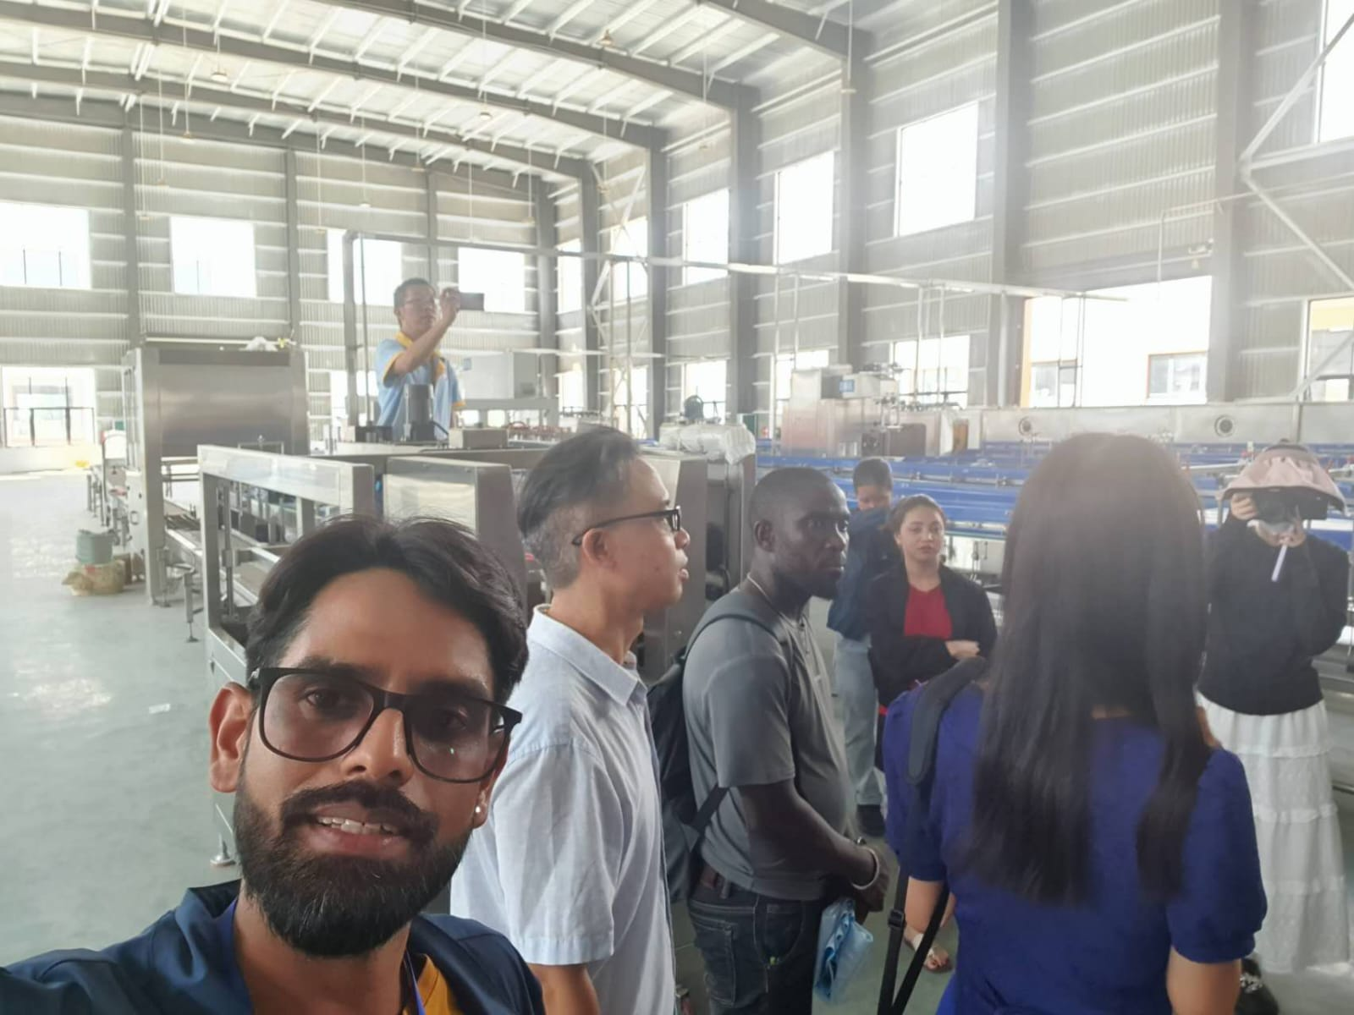

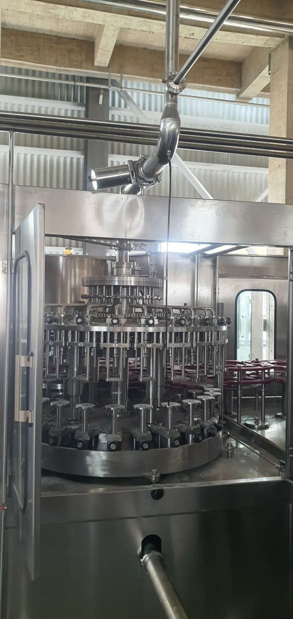
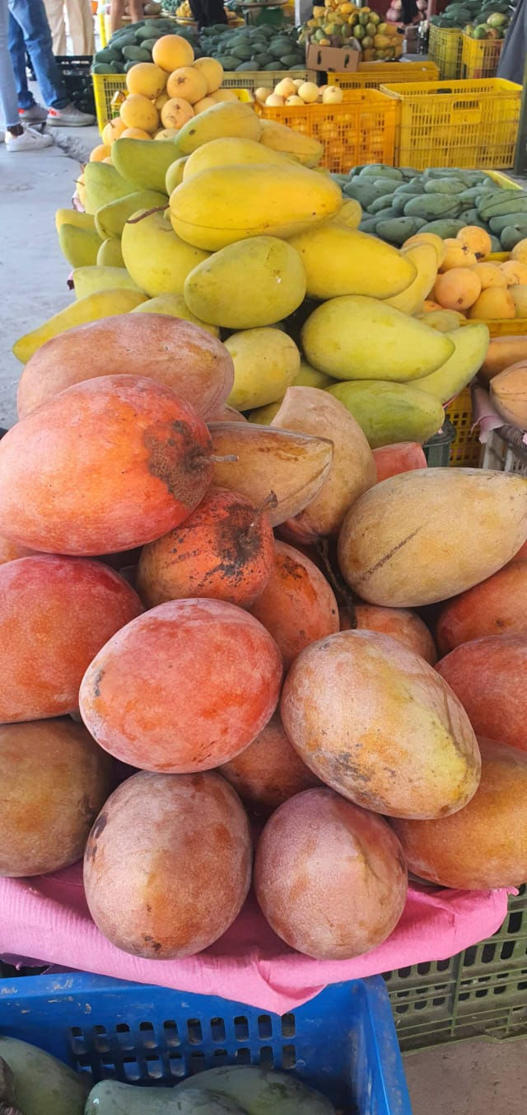
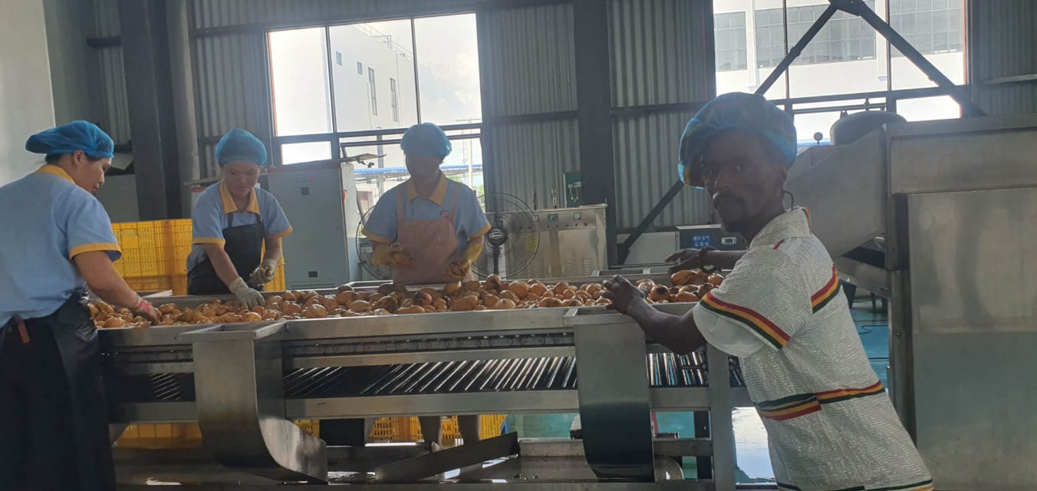
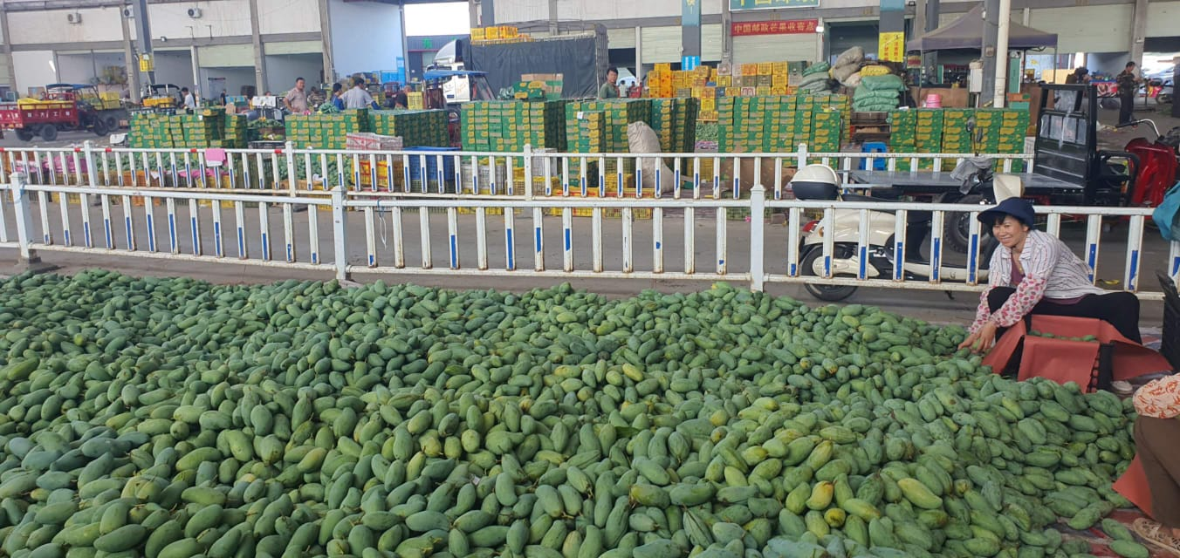
Field Visit Gallery

Slide 47
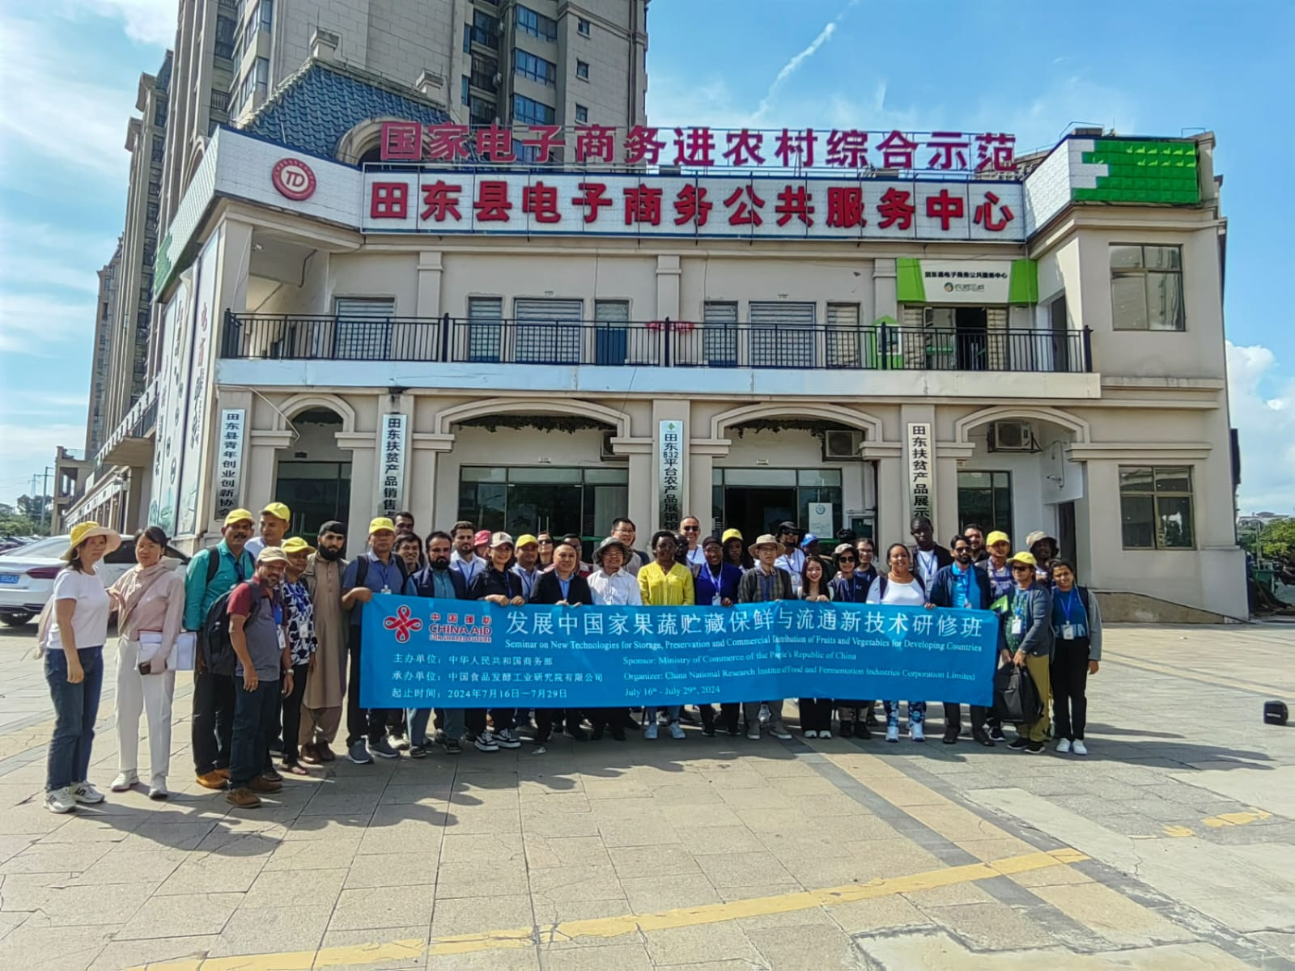

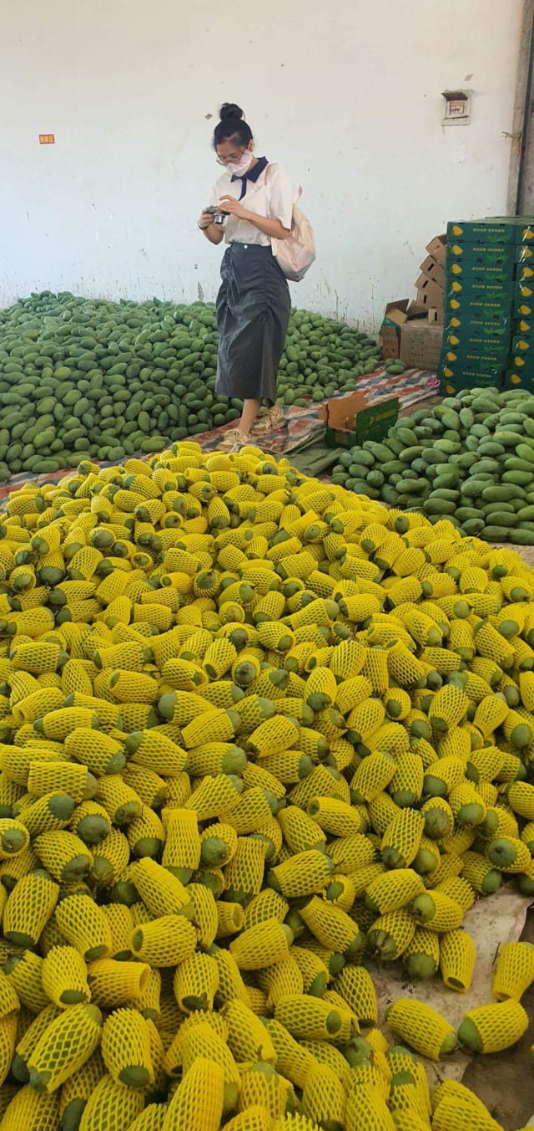
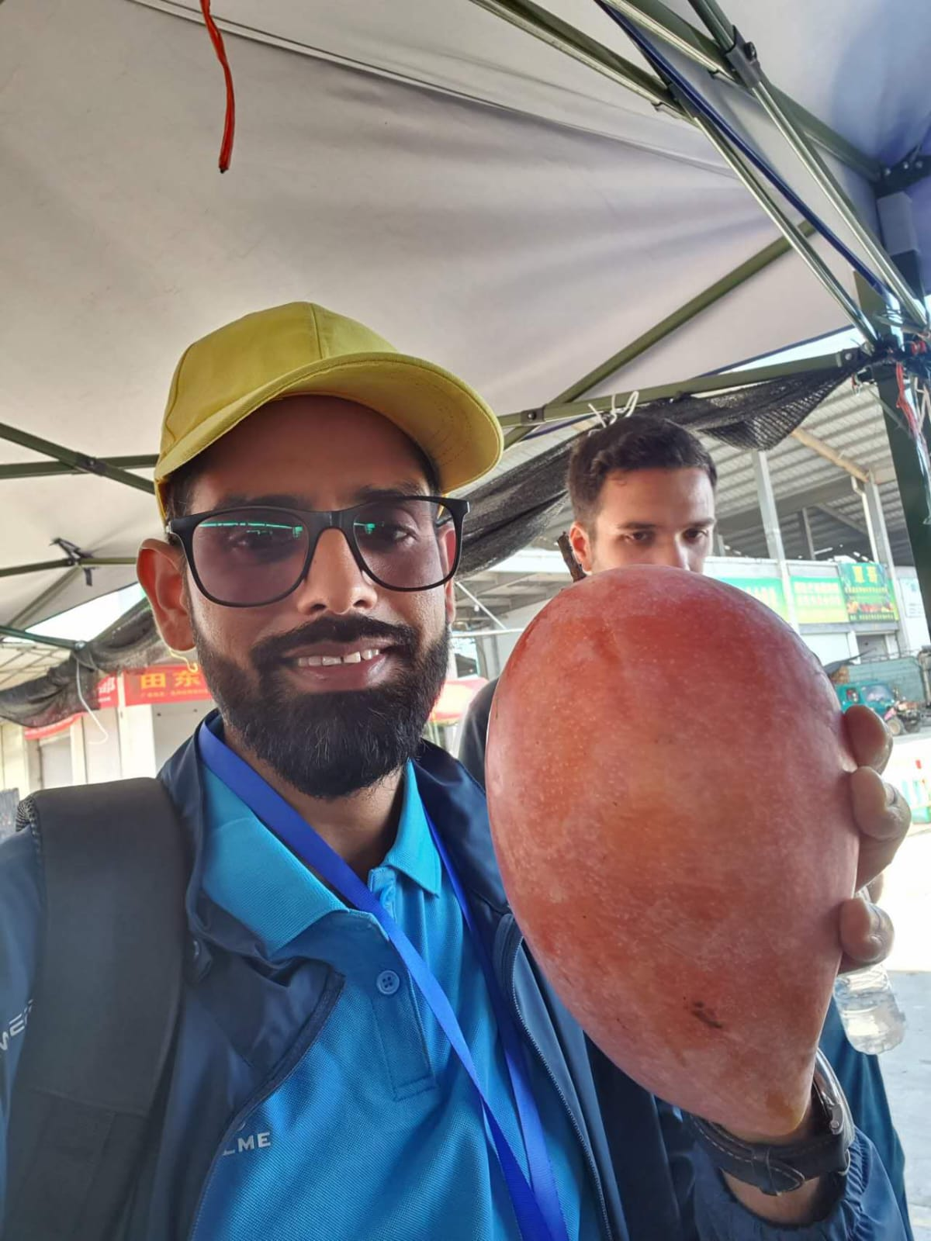

Field Visit Gallery

Slide 48


How dose the knowledge acquired through the training fullfill the need of your organization and country?
1. Improved Efficiency :
Enhanced Techniques: Training provides up-to-date technique for handling, storing and preserving agricultural products, reducing waste and improving efficiency.
Cost Reduction : By adopting better practices, organization can minimize losses and reduce costs associated with spoilage and inefficient storage.

Slide 49

Quality Control
Standardization : Knowledge of best practices ensures that products meet quality standards, enhancing the reputation of product quality and increasing customer satisfaction.
Extended Shelf Life: Proper preservation techniques extend the shelf life of products, allowing for better planning and inventory management.

Slide 50


Market Competitiveness:
Innovation: Staying informed about the latest technologies and methods keeps competitive in the market.
Market Access: Improved quality and efficiency can open up new market and increase the demand for products.

Slide 51


Country Level
Food Security:
Reduced Postharvest losses: Effective storage and preservation techniques reduce postharvest losses, ensuring more food reaches consumers.
Stable Supply: Improved distribution methods ensure a stable supply of agricultural products, contributing to food security.

Slide 52


Economic Growth:
Increased Income for Farmers: Better postharvest management increase the value of agricultural products, providing higher income for farmers.
Job Creation: The development of storage and distribution infrastructure creates jobs and stimulates economic growth.

Slide 53


Continued….
Sustainable Development
Resource Efficiency: Efficient use of resources through better storage and preservation practices supports sustainable agricultural development.
Environmental Protection: Reducing waste and improving resource management helps protect the environment and promotes sustainable practices.

Slide 54


How will the knowledge acquired through the training benefit your personal career?
Enhanced Expertise
Skill development :
Gaining specialized skills in this field adds up valuable asset in the agricultural sector knowledge.
Knowledge Application : Application of advanced techniques to improve efficiency and reduces losses, showcasing ability to implement practical sotlutions.

Slide 55


Continued….
Career Advancement
Professional Growth : With enhanced expertise, it’s more likely to secure promotions and take on leadership roles within organization.
Networking Opportunities: Training program often provide opportunities to connect with industry experts peers, expanding professional networks.

Slide 56


Increased Employability:
Competitive Edge: Specialized knowledge sets us apart from other candidates making more attractive to potential employer.
Versatility: Understanding various aspects allows us to work in different roles and sectors within agriculture.

Slide 57

Continued….
Contribution to National Development:
Impactful Work: By improving practices, we contribute to reducing food waste and enhancing food security in Nepal.
Sustainable Practices: Promoting sustainable storage and distribution methods aligns with national goals for sustainable agricultural developments.

Slide 58


Slide 59
Action plan of disseminating the knowledge obtained from the training to your respective countries.

Slide 60


Objectives Definition:
Purpose: Clearly outline the goals of dissemination, such as improving postharvest practices, reducing losses, and enhancing market access.
Outcomes: Identify the desired outcomes, like increased awareness, adoption of best practices, and policy changes.
Eg:
Improve post harvest management practices among farmers in Province No.2, Nepal.

Slide 61

Target Audience :
Primary Audiences: Farmers, agricultural extension workers, policymakers, and industry stakeholders.
Secondary Audiences: Academic institutions, NGOs, and the general public.
Eg:
5000 farmers from 50 agricultural extension workers , and
10 local policymakers.

Slide 62


Key Messages:
Core Content: Focus on the importance of proper storage, preservation techniques, and efficient distribution methods.
Tailored Messages: Customize messages for different audiences to ensure relevance and engagement.
Eg:
Importance of reducing post harvest losses,
benefits of modern storage techniques, and
efficient distribution methods.

Slide 63


Dissemination Methods:
Workshops and Seminars: Conduct training sessions and workshops for farmers and extension workers.
Eg: Conduct 10 workshops in different districts.
Publications: Create manuals, brochures, and articles to distribute knowledge widely.
Eg: Distribution of 10,000 brochures and 5000 manuals.

Slide 64


Digital Platforms: Use social media, websites, and online forums to reach a broader audience.
Launching a social media campaign targeting young farmers.
Media Engagement: Collaborate with local media to broadcast information through TV, radio, and newspapers.
Eg: Parternering with local radio stations for weekly agricultural programs.

Slide 65

Plan Implementation:
Timeline: Establish a clear timeline for each dissemination activity. Eg: 6 months.
Resources: Allocate necessary resources, including budget, personnel, and materials. Eg: 80 Lakhs budget, 5 trainers and collaboration with local agricultural offices.
Partnerships: Collaborate with relevant organizations and institutions to amplify the reach and impact. Eg: NGO’s , INGO’s , Agricultural Research Centres etc.

Slide 66


Monitoring and Evaluation:
Feedback Mechanisms: Collect feedback from participants and stakeholders to assess the effectiveness of dissemination efforts. Eg:Collection of survey from workshop participants.
Impact Assessment: Measure the impact of the knowledge dissemination on practices and outcomes in the agricultural sector. Eg: Assess changes in postharvest loss rates and adoption of new techniques.
Continuous Improvement: Feedback and assessment results to refine and improve future dissemination strategies.

Slide 67

Heartfelt Thanks for an Enlightening Seminar
We, the participants of the seminar from Nepal on “New technologies for storage, preservation and commercial distribution of fruits and vegetable for developing countries” would like to extend our deepest gratitude for organizing such an informative and impactful event.
The insights and knowledge shared during the seminar have been incredibly valuable. We have gained a deeper understanding of the latest advancements in postharvest management and how these technologies can be applied to improve efficiency and reduce losses in our agricultural practices.
Your dedication to enhancing our knowledge and skills is truly commendable. The practical examples that comprised of field visit and interactive sessions were particularly beneficial, allowing us to grasp complex concepts with ease.
Thank you once again for your efforts in making this seminar a success. We look forward to applying what we have learned and contributing to the advancement of agricultural practices in our respective regions.
Warm regards,
Team Nepal
धन्यवाद

